Slide 1
Unit 2
Structuring of Data

Slide 2
Introduction
A data type defines a collection of data objects and a set of predefined operations on those objects
A descriptor is the collection of the attributes of a variable
An object represents an instance of a user-defined (abstract data) type
One design issue for all data types: What operations are defined and how are they specified?

Slide 3
Primitive Data Types
Almost all programming languages provide a set of primitive data types
Primitive data types: Those not defined in terms of other data types
Some primitive data types are merely reflections of the hardware
Others require only a little non-hardware support for their implementation

Slide 4
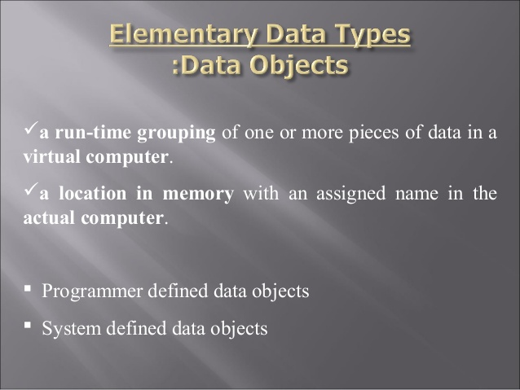

Slide 5
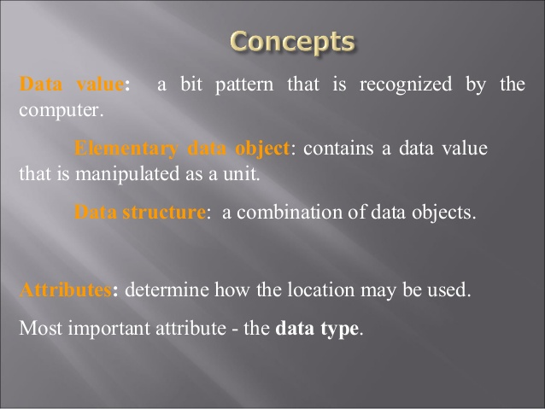
DATA VALUE
Elementary Data Object
DATA Structure
Attributes

Slide 6
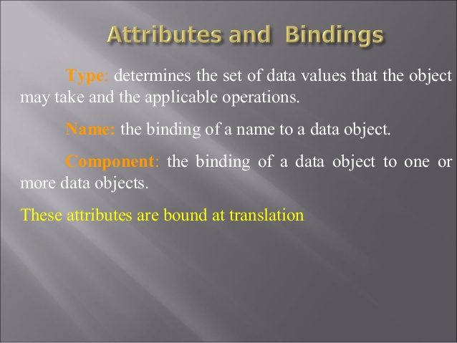
Type
Name
Component

Slide 7
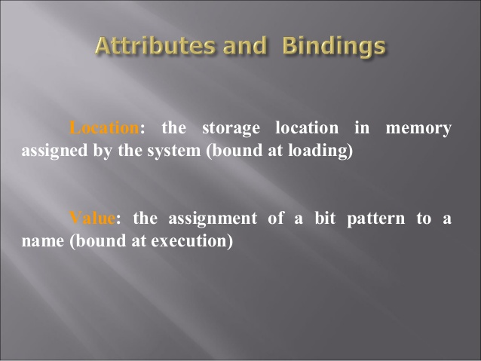
Location
Value

Slide 8
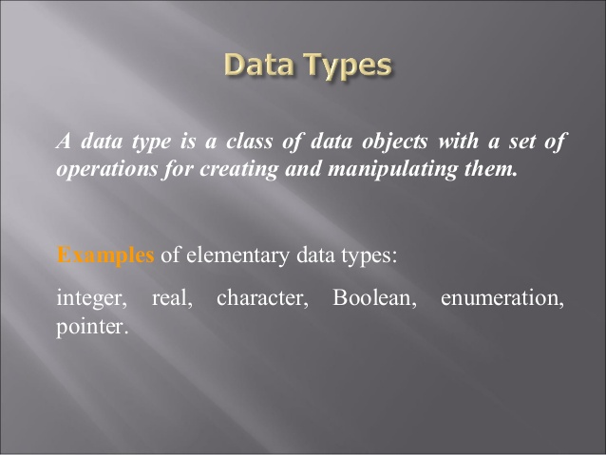
examples

Slide 9
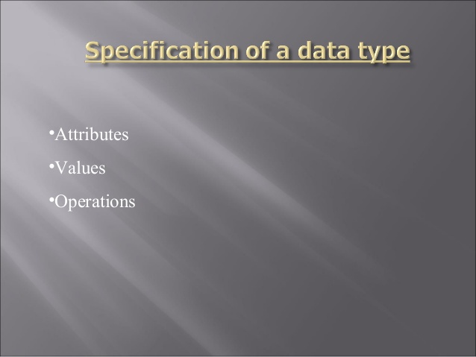

Slide 10
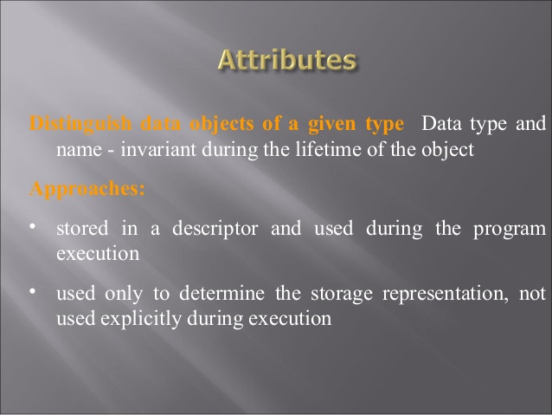
Distinguish data objects of a given type
Approaches

Slide 11
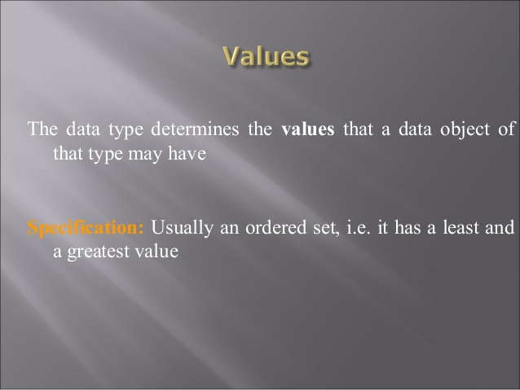
Specifications

Slide 12
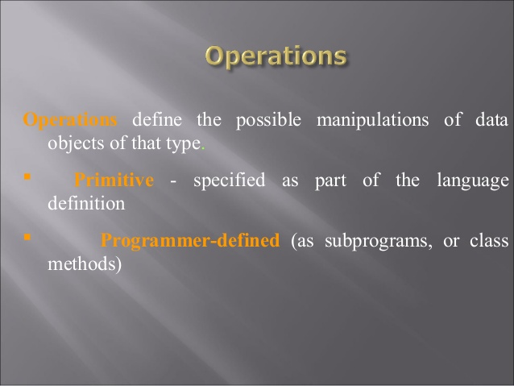
Operations
Primitive
Programmer defined

Slide 13
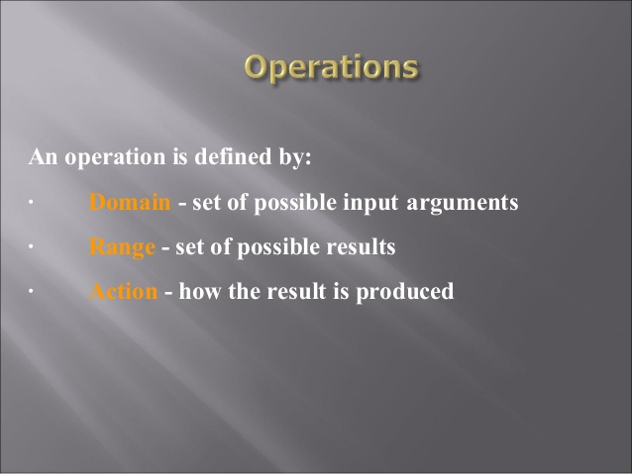
Domain
Range
Action

Slide 14
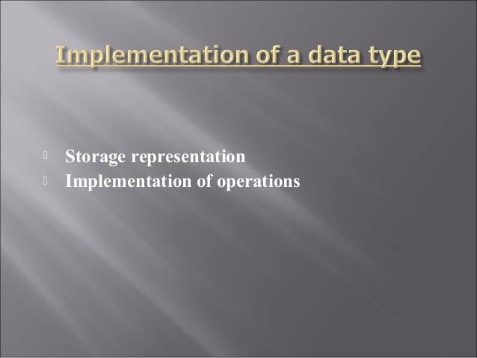

Slide 15
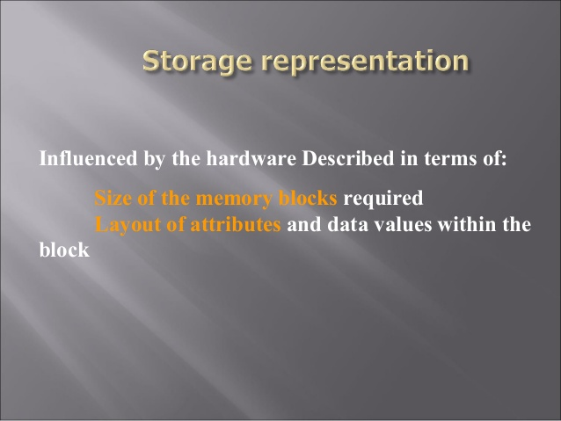
Size of the memory blocks
Layout of attributes

Slide 16
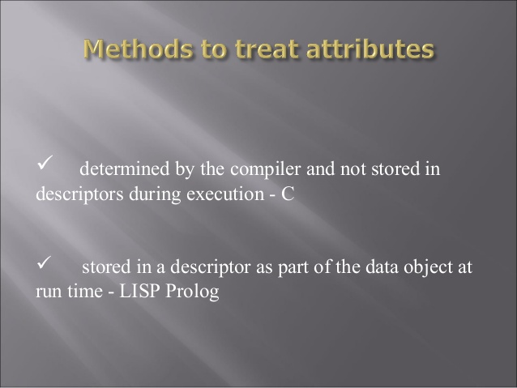

Slide 17
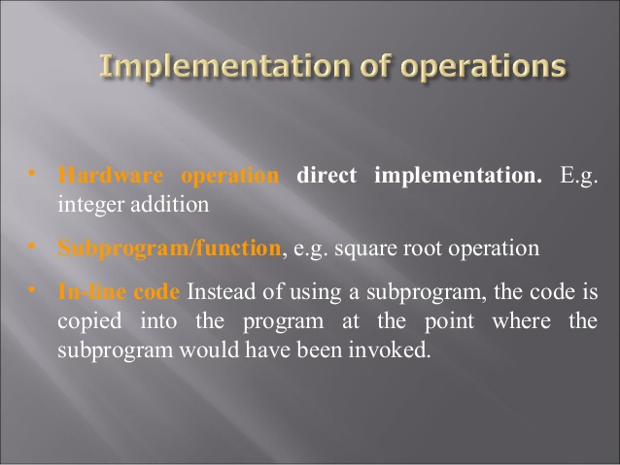
Hardware operations
Subprogram /function
Inline code

Slide 18
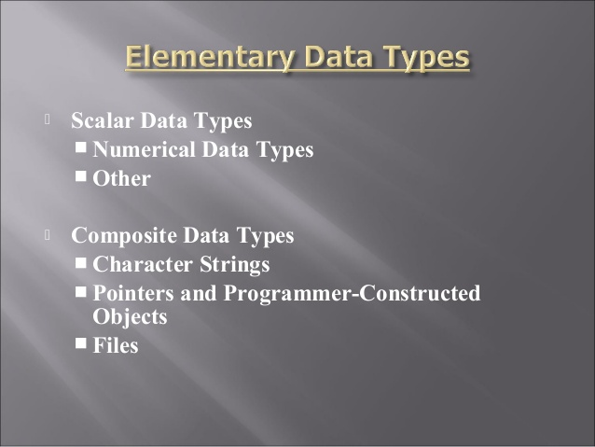

Slide 19
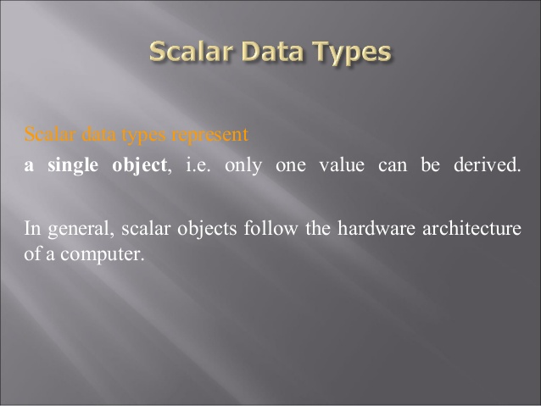
Scalar data type represent

Slide 20
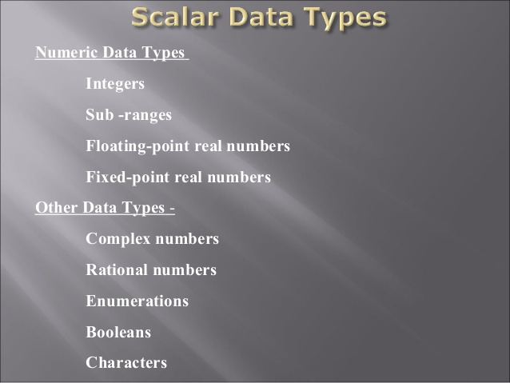

Slide 21
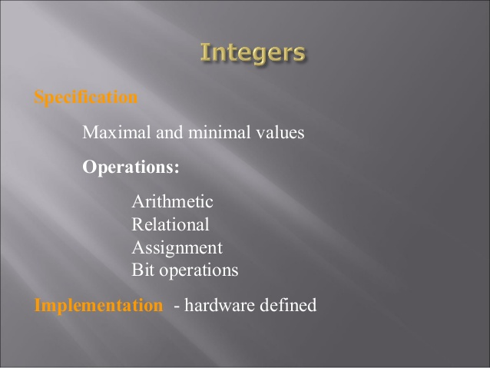
specifications
implementation

Slide 22
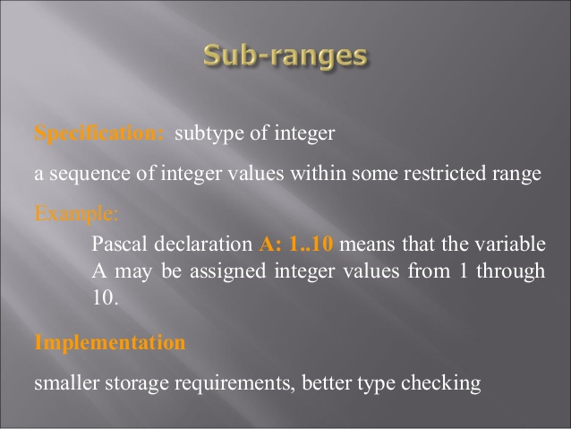
specifications
Exa.
implementation

Slide 23
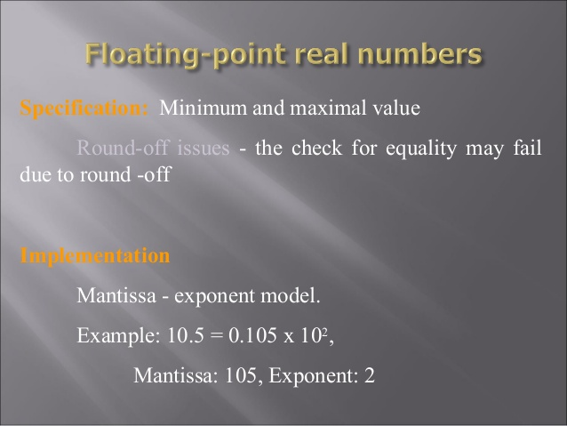
specifications
implementation

Slide 24
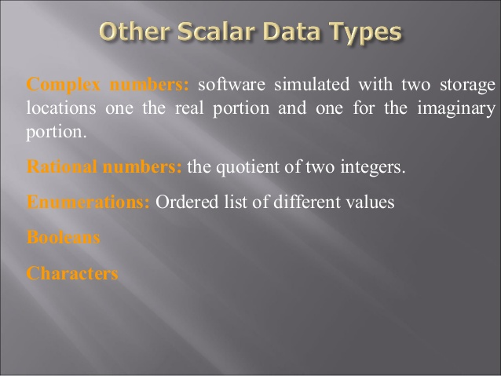
Complex numbers
Rational numbers
Enumeration
Booleans
Characters

Slide 25
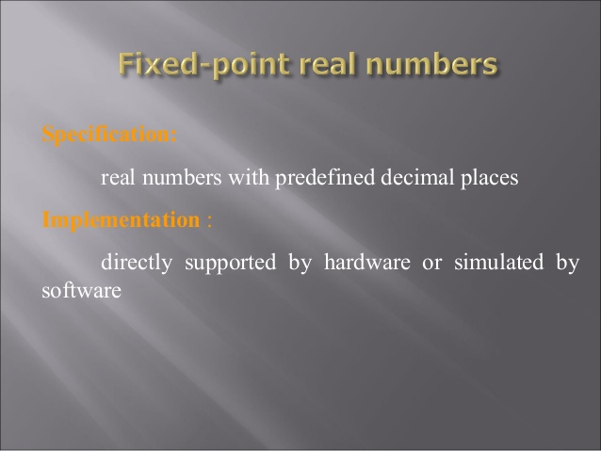
specifications
implementation

Slide 26
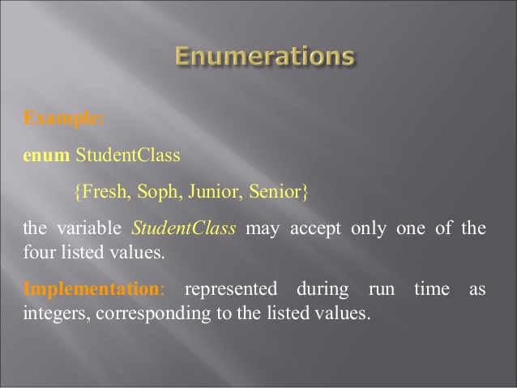
Ex.
implementation

Slide 27
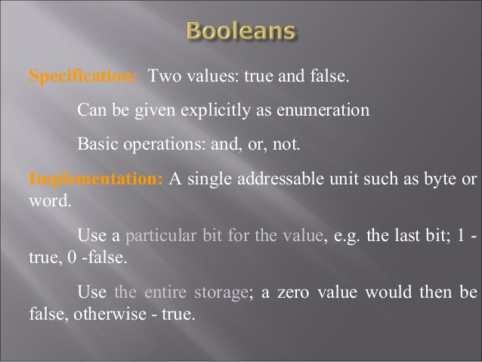
Specification
implementation

Slide 28
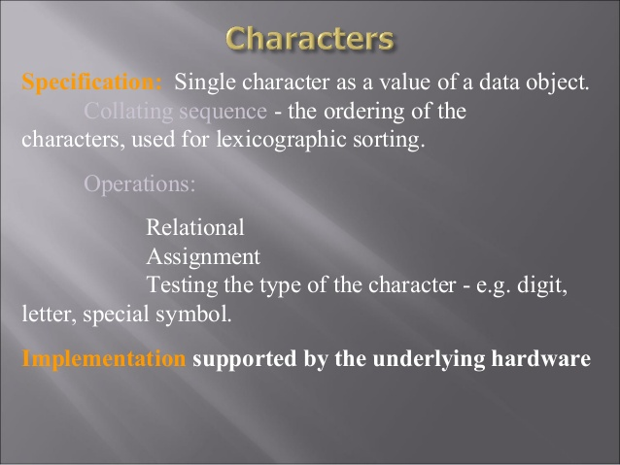
Specification
implementation

Slide 29
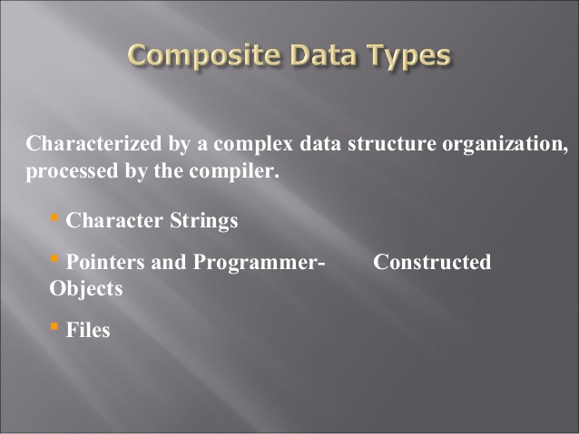

Slide 30
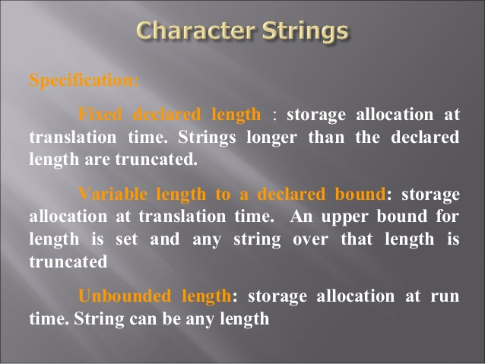
Specification
Fixed declared length
Variable length to a declared bound
Unbounded length

Slide 31
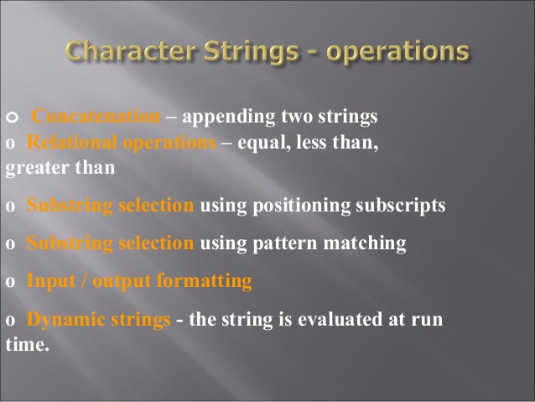
concatenation
Relational operations
Substring selection
Substring selection
Input output formatting
Dynamic strings

Slide 32
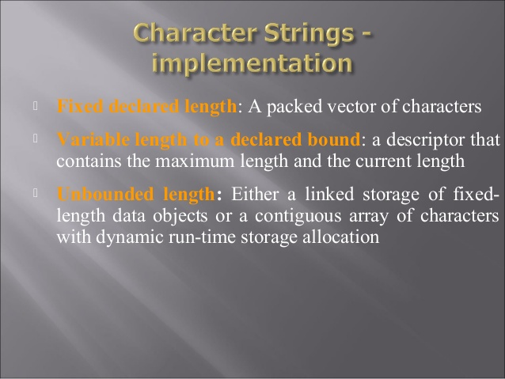
Fixed declared length
Variable length to a declared bound
Unbounded Length

Slide 33
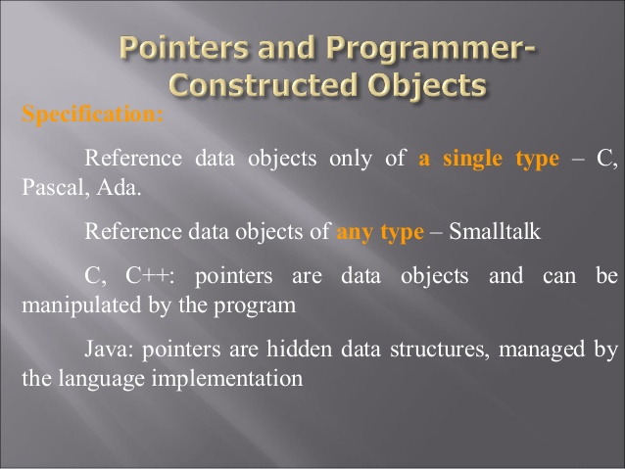
Specification
A single type
Any Type

Slide 34
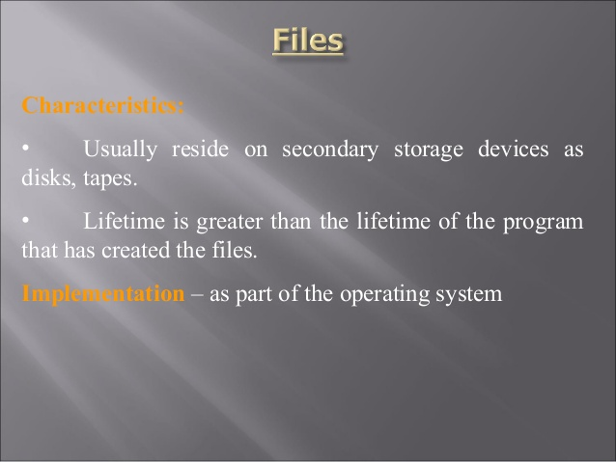
Characteristics
Implementation

Slide 35
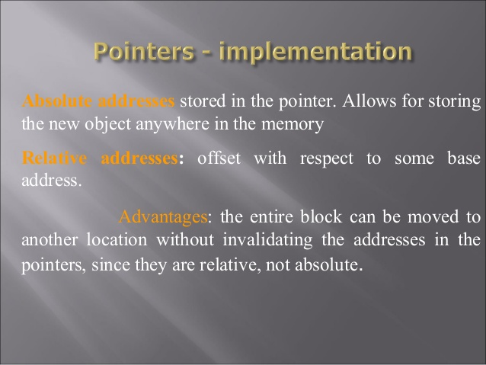
Absolute addresses
Relative addresses
Advantage

Slide 36
Built-in types and primitive types
Any programming language is equipped with a finite set of built-in types (or predefined) types, which normally reflect the behavior of the underlying hardware.
At the hardware level, values belong to the untyped domain of bit strings, which constitutes the universal domain of computer data.
Data belonging to such universal domain are then interpreted differently by hardware instructions, according to different types.
Ex: bit string "01001010"
74 (machine instruction ADD)
I (ASCII character "I" if printed by instruction PCH)

Slide 37
The built-in types of a programming language reflect the different views provided by typical hardware. Examples of built-in types are:
booleans, i.e., truth values TRUE and FALSE, along with the set of operations defined by Boolean algebra;
characters, e.g., the set of ASCII characters;
integers, e.g., the set of 16-bit values in the range <-32768, 37767>; and
reals, e.g., floating point numbers with given size and precision.
Built-in types can be viewed as a mechanism for classifying the data manipulated by a program. Moreover, they are a way of protecting the data against forbidden, or nonsensical, maybe unintended, manipulations of the data.
Data of a certain type, in fact, are only manipulable by the operations defined for the type.

Slide 38
Advantages of built-in types:
1. Hiding of the underlying representation:
This is an advantage provided by the abstractions of higher-level languages over lower-level (machine-level) languages.
The programmer does not have access to the underlying bit string that represents a value of a certain type.
The programmer may change such bit string by applying operations, but the change is visible as a new value of the built-in type, not as a new bit string.
Invisibility of the underlying representation has the following benefits:

Slide 39
Programming style:
increases program readability
protects the representation of objects from undisciplined manipulation.
For example, a location containing an integer may be added to one containing a character, or even to a location containing an instruction.
Modifiability.
The implementation of abstractions may be changed without affecting the programs that make use of the abstractions.
Consequently, portability of programs is also improved, that is, programs can be moved to machines that use different internal data representations.
For example, the range of representable integer values is different for 16- and 32-bit machines.

Slide 40
Programing languages provide features to read and write values of built-in types, as well as for formatting the output.
Such features may be either provided by language instructions or through predefined routines.
Machines perform input/output by interacting with peripheral devices in a complicated and machine-dependent way.
High-level languages hide these complications and the physical resources involved in machine input/output (registers, channels, and so on).

Slide 41
2. Correct use of variables can be checked at translation time:
If the type of each variable is known to the compiler, illegal operations on a variable may be caught while the program is translated.
Although type checking does not prevent all possible errors to be caught, it improves our reliance on programs.
For example, in Pascal or Ada, it cannot ensure that J will never be zero in some expression I/J, but it can ensure that it will never be a character.

Slide 42
3. Resolution of overloaded operators can be done at translation time:
For readability purposes, operators are often overloaded.
For example, + is used for both integer and real addition, * is used for both integer and real multiplication. In each program context, however, it should be clear , which specific hardware operation is to be invoked, since integer and real arithmetic differ.

Slide 43
4. Accuracy control:
(Accuracy of representation with type)
For example, FORTRAN allows the user to choose between single and double-precision floating-point numbers.
In C, integers can be short int, int, or long int. Each C compiler is free to choose appropriate size for its underlying hardware, under the restriction that short int and int are at least 16 bits long, long int is at least 32 bits long, and the number of bits of short int is no more than the number of bits of int, which is no more than the number of bits of long int.

Slide 44
Data Aggregates And Type Constructors
PL allows the programmer to specify aggregations of elementary data objects and, recursively, aggregations of aggregates. They do so by providing a number of constructors.
An aggregate object has a unique name
Routines can also be seen as constructors which allow elementary instructions to be combined to form new operations
Modification can be made on single component or on group.

Slide 45
User-defined types
Modern programming languages provide many ways of defining new types, starting from built-in type. They are called user defined types
the C declaration which introduces a new type name complex
struct complex { float real_part, imaginary_part; } complex a, b, c, ;
Types allow the (otherwise unstructured) world of data to be organized as a collection of different categories
Types also allow data to be protected from undesirable manipulations by specifying exactly which operations are legal for objects of a given type and by hiding the concrete representation.

Slide 46
Abstract data types in C++
An abstract data type is a new type for which we can define the operations to be used for manipulating instances
the data structure that implements the type is hidden to the users.
class point {
int x, y;
public:
point (int a, int b) { x = a; y = b; } // initializes the coordinates of a point
void x_move (int a) { x += a; } // moves the point horizontally
void y_move (int b ){ y += b; } // moves the point vertically
void reset ( ) { x = 0; y = 0; } // moves the point to the origin
};

Slide 47
CONSTRUCTOR
A Normal Constructor takes a parameter values of components of the objects and constructs the object from those components. (Eg. Point constructor takes two integer)
Copy Constructor allows us to build the a new object from an existing object without knowing the components that constitute the object
i.e. point (point&)

Slide 48
Copy Constructor for point could be implemented simply in this way
point(point& p)
{
x=p.x;
y=p.y;
}

Slide 49
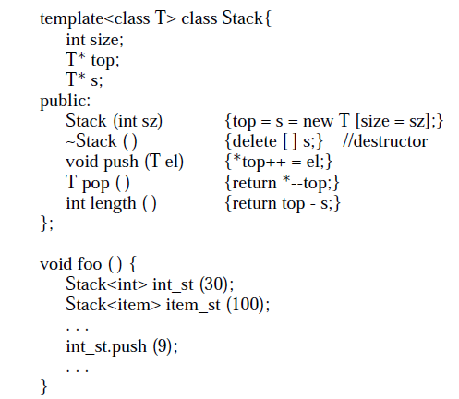
Generic Abstract Data Types
generic abstract data types, i.e., data types that are parametric with respect to the type of their components

Slide 50
Generic Abstract Data Types
An implementation of a generic stack abstract data type in Eiffel.
The definition of preconditions, postconditions,
and invariants are left to the reader as an exercise.
class STACK [T] export
push, pop, length
creation
make_stack
feature
store: ARRAY [T];
length: INTEGER;

Slide 51
Type Systems
Type System: as the set of rules used by the language to structure and organize its collection of types.
Plays important role in understanding the language’s
semantics.
Type: specific set of values and particular set of operations that are applied to those values.
Object/data object: since values in our context are stored somewhere in the memory of a computer, we use the term object (or data object) to denote both the storage and the stored value.

Slide 52
Type error: illegal operations that manipulate data objects are type errors.
Type safe: if all operations in the program are guaranteed to always apply to data of the correct type, i.e., no type errors will ever occur.

Slide 53
Static versus dynamic program checking
Errors can be classified in two categories: language errors and application errors.
Language errors are syntactic and semantic errors in the use of the programming language.
Application errors are deviations of the program behavior with respect to specifications (assuming specifications capture the required behavior correctly).
The programming language should facilitate both kinds of errors to be identified and removed

Slide 54
Error checking can be accomplished in different ways, that can be classified in two broad categories: static and dynamic
Static checking:
Advantages:
Errors are detected without running the code.
Hence errors are detected early, more reliable.
Program becomes easy to understand, maintain due to static checking.
Improves run time efficiency.

Slide 55
Disadvantage:
Increase compile time overhead
Error that may occur on providing particular input may go undetected.

Slide 56
Dynamic checking
Advantages:
Brings flexibility in program design
(data type associated with a variable may change as needed during program execution)
Disadvantage:
Difficult to debug
Checking information needs to be maintained
Extra storage requirement during execution
slows down program execution.

Slide 57
Static checking, though preferable to dynamic checking, does not uncover all language errors.
Some errors only manifest themselves at run time.
For example, if div is the operator for integer division, the compiler might check that both operands are integer. However, the program would be erroneous if the value of the divisor is zero.
This possibility, in general, cannot be checked by the compiler.

Slide 58
Strong typing and type checking
A type system is said to be strong if it guarantees type safety; i.e., programs written by following the restrictions of the type system are guaranteed not to generate type errors.
A language with a strong type system is said to be a strongly typed language.
If a language is strongly typed, the absence of type errors from programs can be guaranteed by the compiler.
A type system is said to be weak if it is not strong. Similarly, a weakly typed language is a language that is not strongly typed.

Slide 59
Type compatibility
A strict type system might require operations that expect an operand of a type T to be invoked legally only with a parameter of type T.
Languages, however, often allow more flexibility, by defining when an operand of another type– say Q–is also acceptable without violating type safety.
In such a case, we say that the language defines whether, in the context of a given operation, type Q is compatible with type T.
Type compatibility is also sometimes called conformance or equivalence.

Slide 60
Type conversions
Implicit
Explicit
Implicit:
Automatically by compiler
No loss of information
Loss of information

Slide 61
Generic types
modern languages allow parameterized (generic) abstract data types to be defined.
A typical example is a stack of elements of a parameter type T, whose operations have the following signatures:
push: stack (T) x T -> stack (T)
--pushes an element on top of the stack
pop: stack (T) -> stack (T) x T
--extracts the topmost element from the stack
length: stack (T) -> int
--compute the length of the stack

Slide 62
The operations defined for the type stack(T) are supposed to work uniformly for any possible type T.
However, since the type is not known, how can such routines be type checked to guarantee type safety?
A possibility is provided by languages like Ada, C++, and Eiffel, where generic types must be explicitly instantiated at compile time by binding parameter types to “real” types, that are known at compile time.
This achieves static typing for each instance of each generic type, and therefore each instance is statically checked to ensure type safety

Slide 63
Summing up: monomorphic versus polymorphic type systems
A simple strong type system can be provided by a statically typed language,
where every program entity (constant, variable, routine) has a specific type, defined by a declaration, and every operation requires that an operand of exactly the type that appears in the operation definition can be provided.
For such a language, it is possible to verify at compile time that any occurrence of that constant, variable, or routine is type correct.
Such a type system is called monomorphic , (“Single Shape”) every object belongs to one and only one type.

Slide 64
By contrast, in a polymorphic (“multiple shape”) programming languages every constant and every variable can belong to more than one type. Routines (e.g., functions) can accept as a formal parameter actual parameters of more than one type

Slide 65
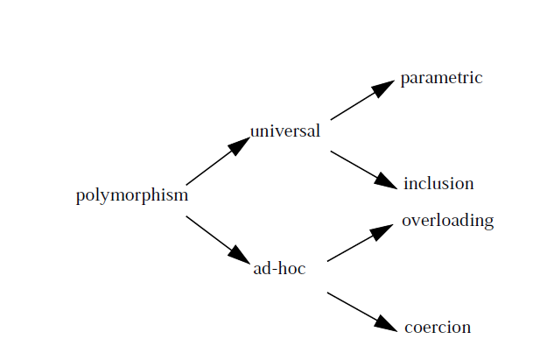
Monomorphic Versus Polymorphic Type Systems

Slide 66
Ad-hoc polymorphic functions work on a finite and often small set of types and may behave differently for each type.
Universal polymorphism characterizes functions that work uniformly for an infinite set of types, all of which have some common structure

Slide 67
Universal polymorphism: parametric and inclusion
Subtyping, is an example of inclusion polymorphism
Parametric polymorphism is perhaps the most genuine form of universal polymorphism.
In this case the polymorphic function works uniformly on a range of types that are specified as parameters.
Generic routines, are examples of parametric polymorphic functions

Slide 68
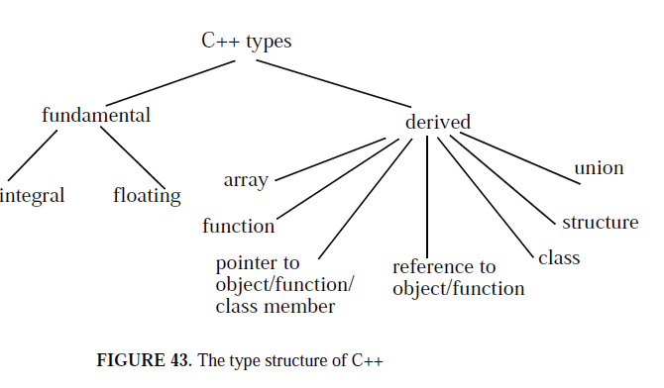
Type Structure in C++

Slide 69
Type Structure in C++
C++ distinguishes between pointers and references. A reference is an alias for an object.
once a reference is bound to an object, it cannot be made to refer to a different object
int i = 5;
int& j = i;
i and j denote the same object, which contains the value 5.
routine declaration
void fun (int& x, float y)
x represents a by-reference parameter, which is bound to its corresponding actual parameter when the routine gets called.

Slide 70
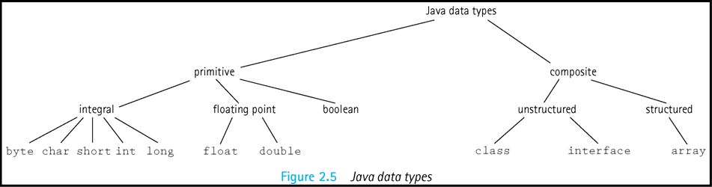
Type Structure in Java

Slide 71
Type Structure in Java
Atomic or primitive type: A data type whose elements are single, non decomposable data items (as primitives in Java)
Composite type A data type whose elements are composed of multiple data items
Structured composite type An organized collection of components in which the organization determines the means of accessing individual data components or subsets of the collection

Slide 72
Structuring the Computation
How computations are structured in a programming languages in terms of the flow of control among the different components of a program(unit level, statement level)
Expressions:
Obtaining values
denote mathematical functions
are invoked using the function’s signature(unary, binary, n-ary operator is applied to n operands)
operator’s notation( in,pre,post)

Slide 73
Operator associativity and operator precedence:
a + b ∗ c corresponds to a+(b∗c) (Pascal,C,...) a=b < c corresponds to (a=b)< c (Pascal) a==b < c correspondstoa==(b < c) (C)
Conditional expressions:
(a > b)? a:b (C)
if a > b then a else b (ML)
case x of 1=>f1(y) | 2=> f2(y) | => g(y) (ML)

Slide 74
Conditional Statements
Let us start with the example of the if statement as originally provided by Algol 60. Two forms are possible, as shown by the following examples:
Algol 60. Two forms are possible, as shown by the following examples:
if i = 0 if i = 0
then i := j; then i := j
else begin i := i + 1;
j := j - 1
end

Slide 75
Conditional Statements
if x> 0 then if x< 10 then x:=0 else x:=1000
if x> 0 then begin if x< 10 then x:=0 end else x:=1000
if x> 0 then if x< 10 then x:=0 end else x:=1000 end
if a then S1 else if b then S2 else if c then S3 else S4 end

Slide 76
end if in the case of Ada, end in the case of Modula-2
coded in Modula-2 as
if i = 0
then i := j
else i := i + 1;
j := j - 1
end
if x > 0 then if x < 10 then x := 0 else x := 1000 end end
Or
if x > 0 then if x < 10 then x := 0 end else x := 1000 end

Slide 77
switch(operator){ case’+’:result=operand1+operand2;
break;
case’-’:result=operand1-operand2;
break;
default:break;}
(In Ada)
case OPERATOR is
when ’+’ => result:=operand1+operand2;
when ’−’ => result:=operand1−operand2;
when others => null; endcase

Slide 78
Loops
for var:=lower to upper do statement (Pascal)
for (inti=0;i < 10;i++) {...} (C++)
for var in discrete range loop body endloop (Ada)
while condition do statement (Pascal)
while (expression)statement; (C)
while condition loop loop body endloop (Ada)

Slide 79
Routines
allows programs to be broken into several units
Routine calls are control structures that govern the flow of control among program units

Slide 80
Routines
The relationships among routines defined by calls are asymmetric
The caller transfers control to the callee by naming it explicitly.
The callee transfers control back to the caller without naming it.
Two kinds of routines: procedures and functions

Slide 81
Routines
A procedure does not return a value: it is an abstract command which is called to cause some desired state change
A function corresponds to its mathematical counterpart: its activation is supposed to return a value, which depends on the value of the transmitted parameters.

Slide 82
Routines
Pascal provides both procedures and functions
It allows formal parameters to be either by value or by reference.
It also allows procedures and functions to be parameters, as shown by the following example

Slide 83
Routines
The example would be written in C++ as follows.
void proc (int& x, int y)
{
x = x + y;
}
proc (a, b); // no address operator is needed in the call

Slide 84
Style issues: Side effects and aliasing
Finding error or cause of error due to use of
non local variable
unrestricted access to nonlocal variables is particularly dangerous when the program is large and composed of several units.

Slide 85
Style issues: Side effects and aliasing
Parameter passing by reference
Actual parameter might get modified due to parameter passing by reference.
Procedure does not return any value.
Function have serious side effects
ex result=a+fun(a,b)
If function uses parameter passing by reference then fun might produce a change in a or b.
Reduce the readability

Slide 86
Style issues: Side effects and aliasing
Aliasing may arise during the execution of a procedure when parameters are passed by reference.
C++ procedure, which is supposed to interchange the values of two integer variables without using any local variables
void swap (int& x, y)
{
x += y;
y = x - y;
x -= y;
}

Slide 87
Style issues: Side effects and aliasing
Except when the two actual parameters are the same variable, as in the call
swap (a, a);
the procedure sets a to zero, because x and y become aliases and thus any assignments to x and y within the procedure affect the same location

Slide 88
Style issues: Side effects and aliasing
same problem may arise from the call
swap (b [ i ], b [ j ]);
when the index variables i and j happen to be equal
Pointers can cause the same problems
swap (*p, *q)
does not interchange the values pointed at by p and q if p and q happen to point to the same data object.

Slide 89
Style issues: Side effects and aliasing
The above aliases occur because of the following two conditions.
Formal and actual parameters share the same data objects.
Procedure calls have overlapping actual parameters.
if procedure swap is rewritten as

Slide 90
C++ Exception Handling
throw − A program throws an exception when a problem shows up. This is done using a throw keyword.
catch − A program catches an exception with an exception handler at the place in a program where you want to handle the problem. The catch keyword indicates the catching of an exception.
try − A try block identifies a block of code for which particular exceptions will be activated. It's followed by one or more catch blocks.

Slide 91
try
{
// protected code
} catch( ExceptionName e1 )
{
// catch block
} catch( ExceptionName e2 )
{
// catch block
} catch( ExceptionName eN )
{ // catch block }

